Slide 1


Entertainer Data Analytics
By – V H Nidhi

Slide 2
Introduction
Our project explores the complex data landscape in the entertainment sector, aiming to uncover valuable insights that can guide decision-making processes and elevate the overall entertainment experience.
The project’s objective is to analyze information about entertainers by compiling data and creating a comprehensive dashboard.
Tools used are MS Excel, Python, Pandas, IMDB, Power BI

Slide 3


Data Preparation
- The data was divided into three categories: Entertainer Basic Info, Entertainer Breakthrough Info, and Entertainer Last Work Info.
- These three parts were consolidated into a single file named "Entertainer Final."
- The initial data was insufficient for analysis, necessitating the addition of more information.
- Details on the number of awards and nominations won by the entertainers, as well as awards from breakthrough performances, were incorporated into the data.
- Additional information was sourced from IMDb's official website.

Slide 4




Data Enrichment Process

Slide 5
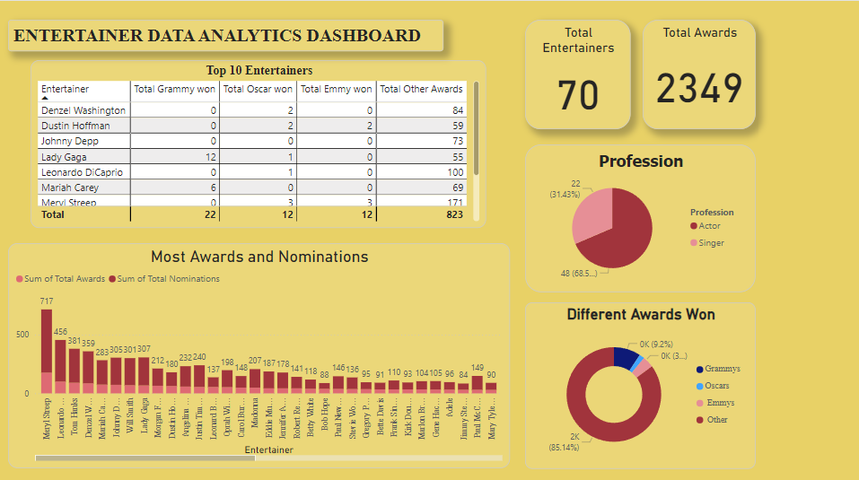
Dashboard 1
The top left table shows the top ten entertainers by total awards.
The bottom left chart shows the entertainers' total nominations and awards.
The bottom right chart shows the distribution of different awards.
Above that, there is a pie chart showing the distribution of professions between singers and actors.
At the top right, it shows the total number of entertainers and the sum of awards won by all entertainers.

Slide 6
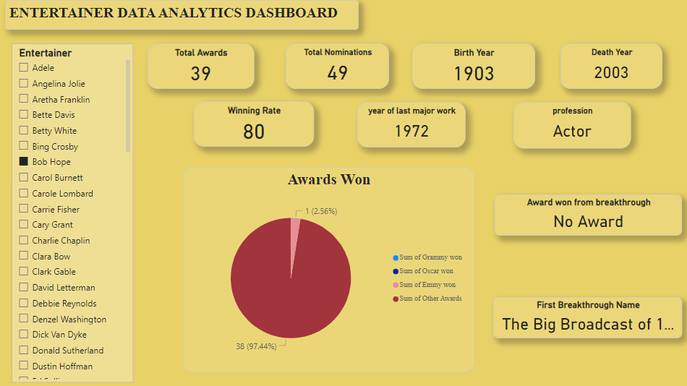
Dashboard 2
This dashboard shows the individual information about the entertainers like total awards, total nominations, winning rate, profession, birth year, first breakthrough name, last major work year, etc.
The left side features a slicer with a list of entertainers, allowing us to select and view their information.

Slide 7
My Design

Slide 8
THANK YOU
By – V H Nidhi

